Slide 1
BC wildfire predictive model
Group 1
Tolu, Dien, Chiyu

Slide 2
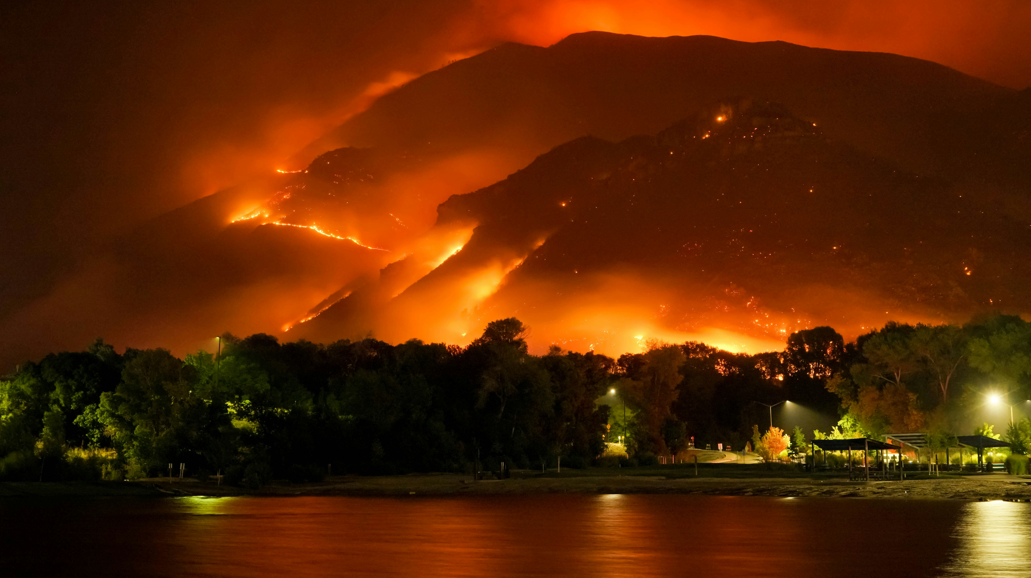
Why wildfires?
Photo by Mike Newbry on Unsplash

Slide 3
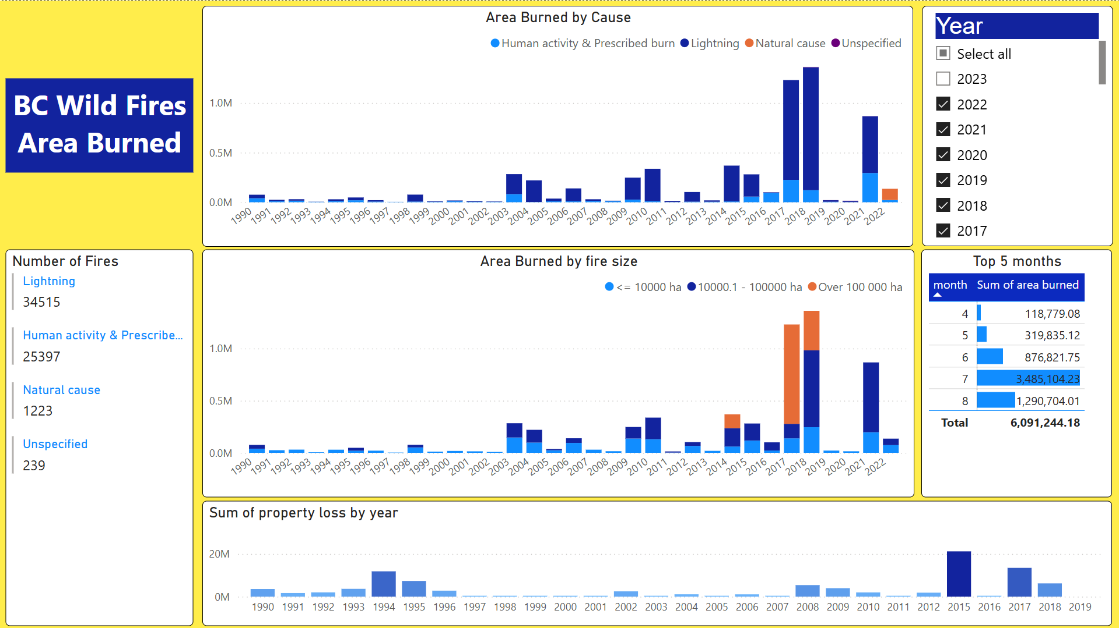

Slide 4
Table of contents
Variables we plan to use
Two Data Building Procedures
PyGIS
Python Analytics
Forcasting Model Planning
Model Applications

Slide 5
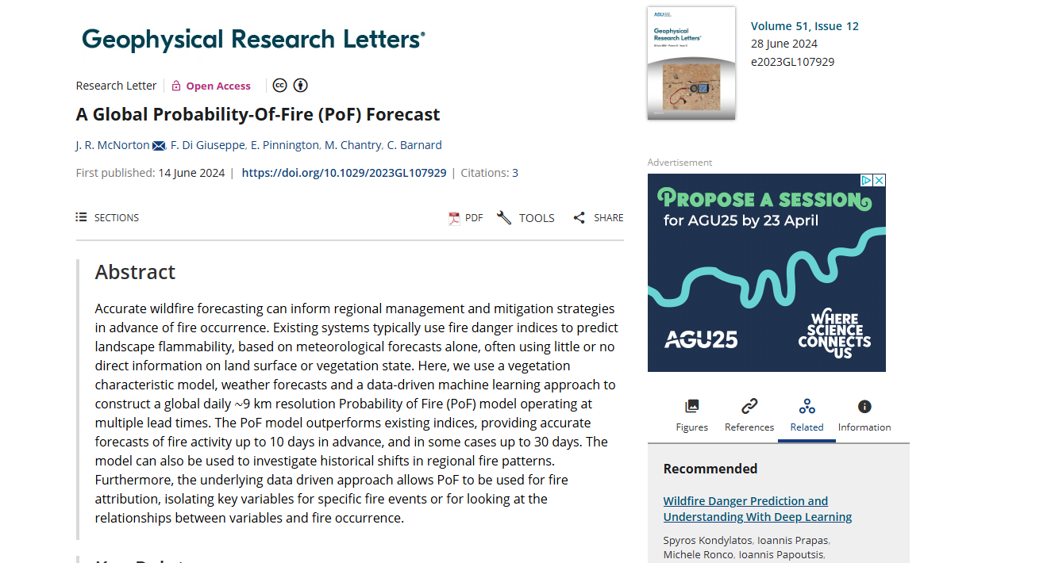
Probability of Fire procedures
Traditional model : solely based on Fire Weather Index (FWI, Van Wagner, 1974)
Neglect: the moisture state of living vegetation, the type of vegetation or the abundance of fuel available to burn in the event of a fire
FWI overestimates fire danger in fuel limited regions and occasionally regions with high live moisture content
McNorton, J. R., et al. A Global Probability-Of-Fire (PoF) Forecast. 14 June 2024

Slide 6
Variables
Variable | Fire Behavior Role | Why It’s Useful
2m temperature | Fuel ignition | Higher temps → drier, more flammable fuels
2m dewpoint temperature | Moisture content in air | Lower dewpoint = lower fuel moisture
10u & 10v wind | Fire spread direction & speed | Drives how fast and where fires travel
Total precipitation | Fuel moisture replenishment | Rainfall reduces fire risk

Slide 7
Variables (cont)
Variable | Fire Behavior Role | Why It’s Useful
Fuel type | Influences ignition and burn intensity | Different fuel types burn at different rates and intensities
Leaf Area Index, High Vegetation | Affects fuel load and canopy density | Higher LAI = more available biomass, which increases burn potential and fire spread

Slide 8
Two data building procedures
PyGIS
Python analytics

Slide 9
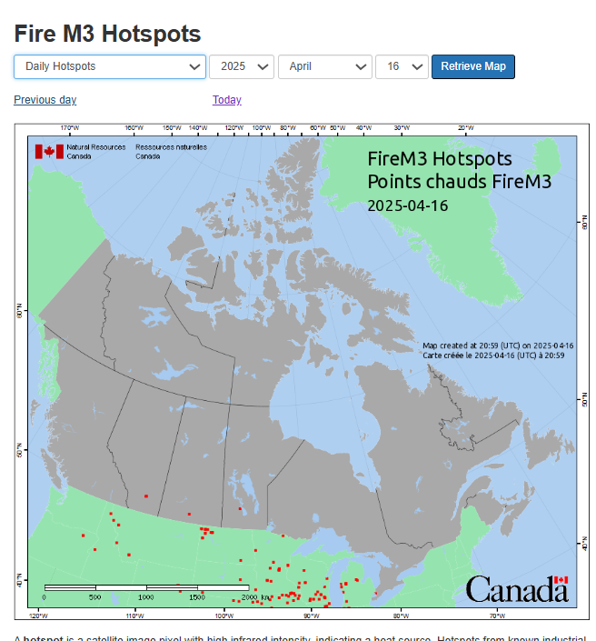
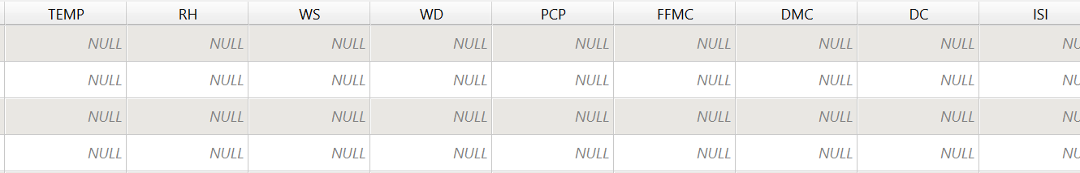
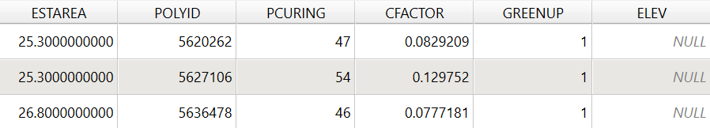
Data sources
1994 hotspot data:
2014 hotspot data:​

Slide 10
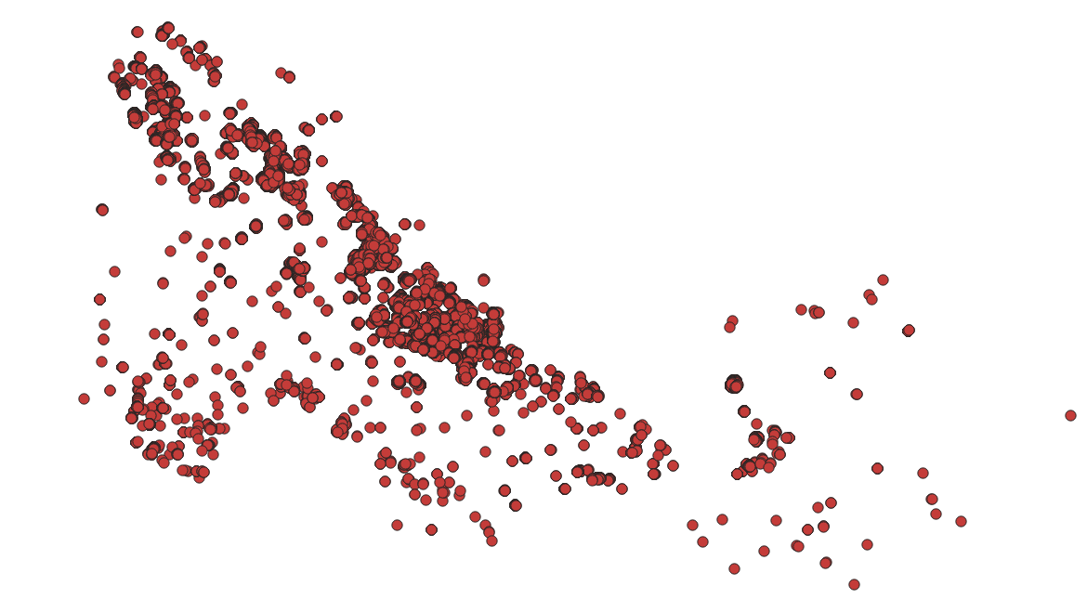
Data cleaning
1994 hotspots:

Slide 11
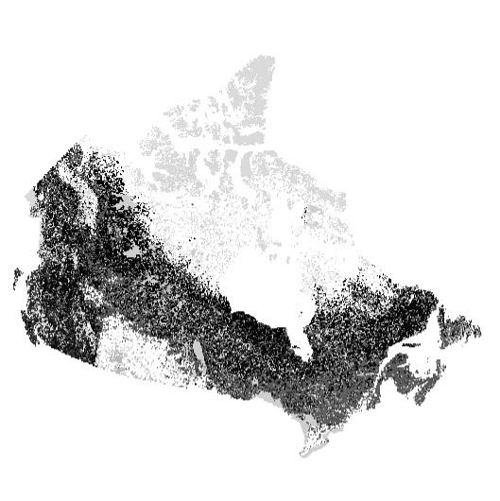
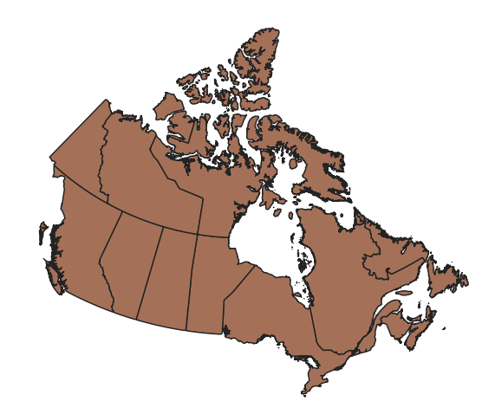
Data cleaning
Map of Canada
Map of Canada by fuel type

Slide 12
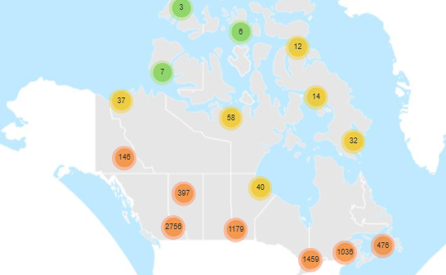
Data cleaning

Slide 13


Data cleaning
Climate data like this for all months and years (Over 60000!):
BC climate data from April 1994 (17 rows):

Slide 14
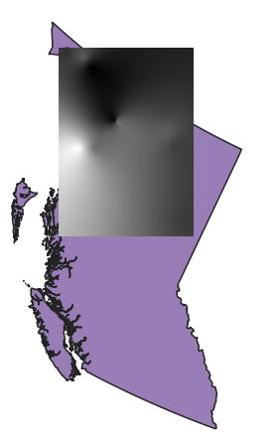
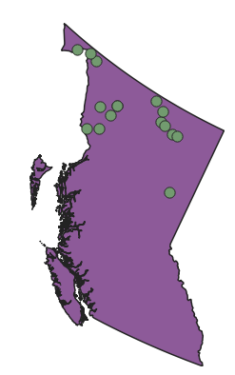
Data cleaning
Cleaned climate data for January 1994
Kriged climate data for January 1994

Slide 15
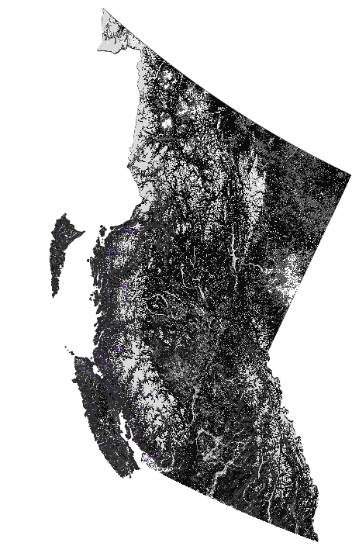
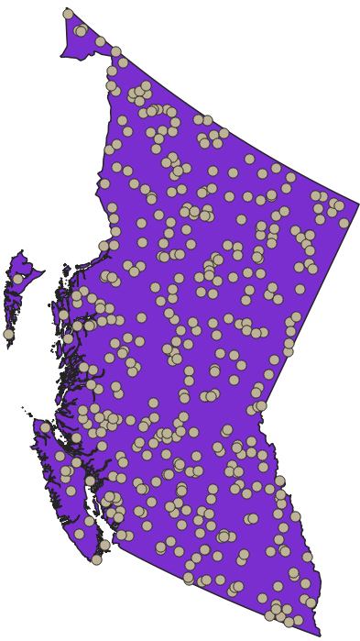
Data cleaning
Fuel type data
Kriged climate data
Fire and non-fire points

Slide 16
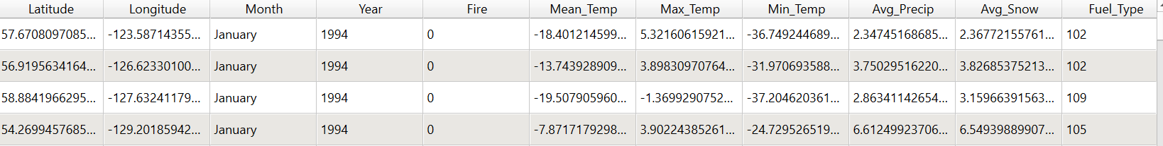
Final attribute table!

Slide 17
Drawback
Lack of data

Slide 18
Python analytics procedure
Data source
MODIS Fire Occurrence Data (MCD14ML Collection 6)
Source: NASA FIRMS (Fire Information for Resource Management System)
Type: Satellite-based fire detections
Frequency: Daily (exact acquisition time)
Purpose : Used to create binary fire labels (1 = fire, 0 = no fire)
ERA5 hourly data on single levels from 1940 to present
Source: Copernicus Climate Data Store (ECMWF - European Centre for Medium-Range Weather Forecasts)
Type: Reanalysis-based climate model output (gridded meteorological data
Frequency: Hourly -> aggregate to Daily
Purpose: Used to merge with the fire occurrence data to get the full database of fire/non-fire occurrence

Slide 19
Data preparation
MODIS fire data is point-based (lat/lon at high resolution, ~1km)
ECMWF forecast data is grid-based (lower resolution, often ~1.0° or 0.25°)
To merge them:
We need to map MODIS points into the ECMWF grid, by:
Rounding coordinates
Merge by month/year/lat grid/lon grid

Slide 20
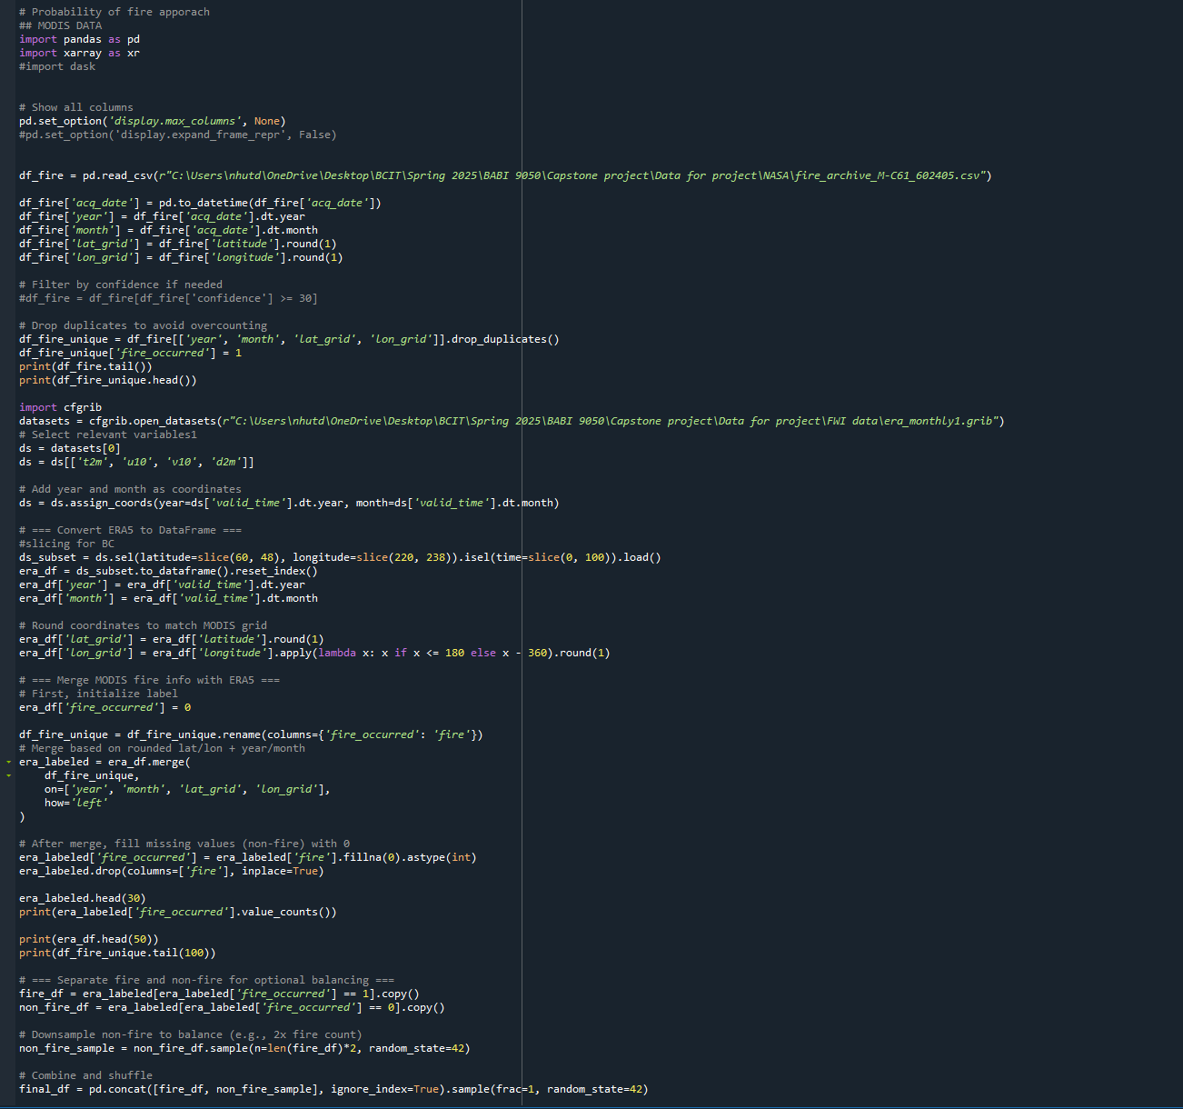
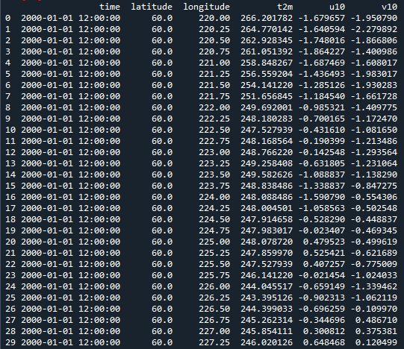
Python code
Result

Slide 21
Forecasting model planning
Random Forest
Logistic regression
XGBoost
McNorton, J. R., et al. A Global Probability-Of-Fire (PoF) Forecast. 14 June 2024

Slide 22
Model application
Predicting the probability for fire in a certain date
With the condition that the fire will happen, predicting the property damage

Slide 23
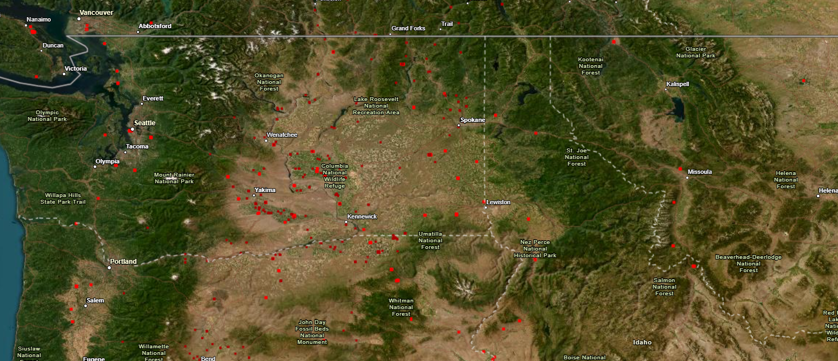
Application (cont)

